Slide 1

Introduction To AI Even Semester Session 2025-26
Multimodal Sentiment Analysis
Tushar Chandra Pant , Tushar Mishra , Shresth Yadav , Utkarsh Sanre
Project Supervisor:
Supervisor Name: Mr. Apoorv Jain
Designation: Assistant Professor

Slide 2

Multimodal Sentiment Analysis Project Overview
This project report presents a multimodal sentiment analysis system integrating facial expression recognition and text sentiment analysis. The system uses Convolutional Neural Networks (CNN) to classify emotions from images and TextBlob for analyzing text polarity. By combining these modalities, it aims to improve the accuracy and robustness of sentiment detection.
Developed by Tushar Chandra Pant, Tushar Mishra, Utkarsh Sanre, and Shresth Yadav under the supervision of Mr. Apoorv Jain, this work contributes to affective computing and human-computer interaction.

Slide 3

Introduction and Problem Statement
Overview
Challenges
Combines visual and textual data to capture human emotions more comprehensively than single-modality methods.
Single-modality models miss nonverbal cues or contextual information, leading to misclassification.
Objective
Design a Python-based framework integrating CNN for facial emotion recognition and TextBlob for text sentiment, fusing both for final sentiment classification.

Slide 4
Literature Review and Technologies
Recent Advances
Technologies Used
Deep learning models like CNNs and transformers enable joint modeling of images and text, improving sentiment prediction.
Frameworks and tools include TensorFlow, PyTorch, Pillow, TextBlob, and visualization libraries.
Image preprocessing with PIL/OpenCV
Fusion techniques: early, late, hybrid
Text analysis with TextBlob and transformers
Use of pretrained models (VGG, BERT)
Data handling with NumPy and pandas
Challenges: modality alignment, noisy data

Slide 5


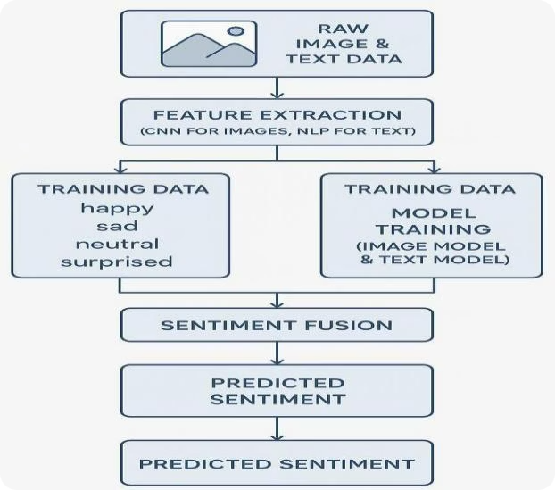



System Design and Architecture
Data Collection & Preparation
Aggregates labeled image-text pairs, ensuring balanced training, validation, and test splits.
Preprocessing
Normalizes images and tokenizes text, aligning multimodal inputs for model consumption.
Model Architecture
Combines CNN-based image encoder and transformer-based text encoder with fusion layers for sentiment classification.
Training & Evaluation
Uses cross-entropy loss, Adam optimizer, and early stopping; evaluates with accuracy, confusion matrix, and visualizations.

Slide 6
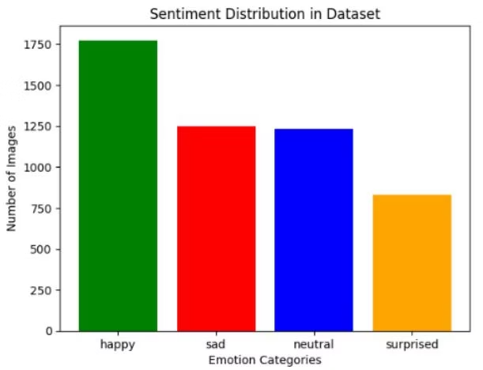
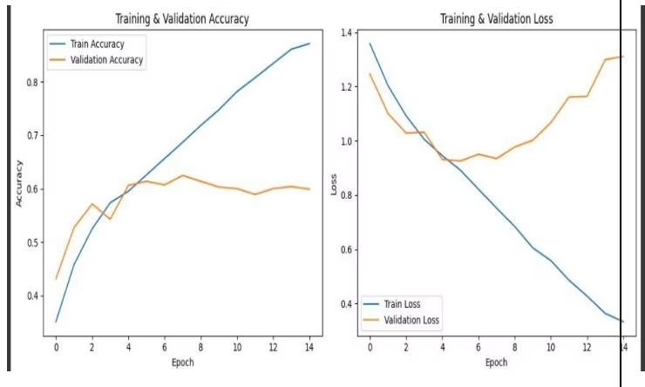
Implementation and Model Performance
Dataset Preparation
Training Results
Organized facial images into four emotion categories: happy, sad, neutral, surprised.
Images resized to 64×64 pixels and normalized for CNN input.
Model trained over 15 epochs showed steady accuracy improvement and effective convergence.

Slide 7

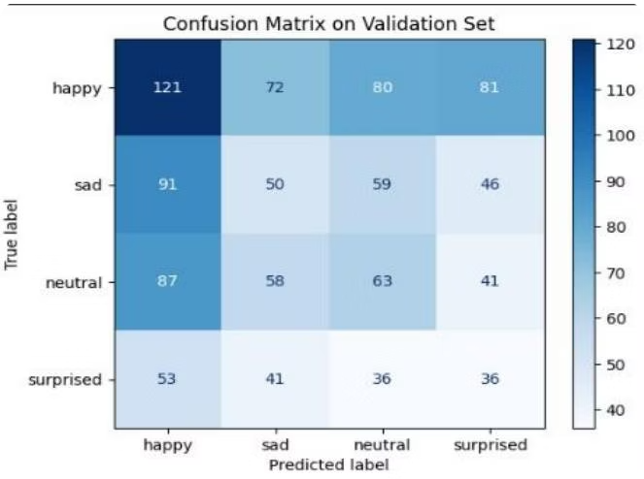
Evaluation and Multimodal Fusion
Confusion Matrix Insights
Text Sentiment Analysis
Strong classification for happy emotions; some confusion between sad and neutral; surprised category is most challenging.
TextBlob polarity scoring effectively classifies positive, negative, and neutral sentiments but struggles with complex nuances.
Multimodal Fusion
Combines image and text sentiments; agrees on final sentiment or labels as "Mixed" when conflicting, enhancing robustness.

Slide 8
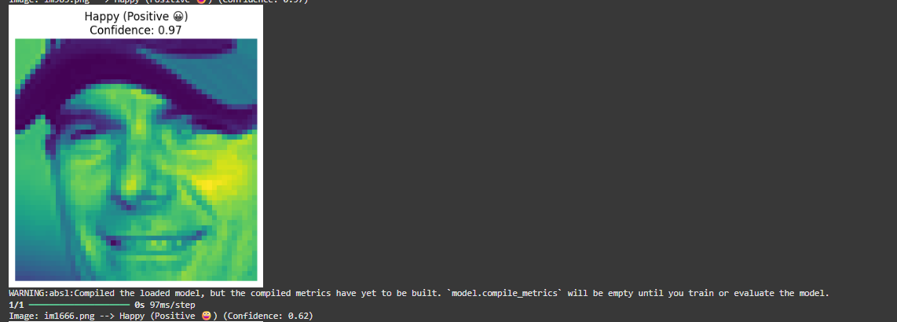
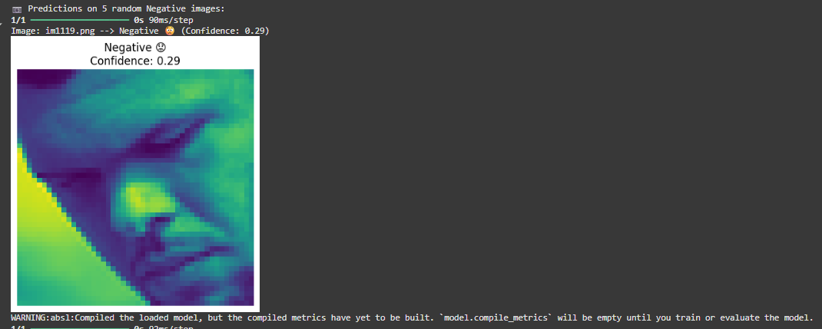
Output of Sentiment analysis:

Slide 9
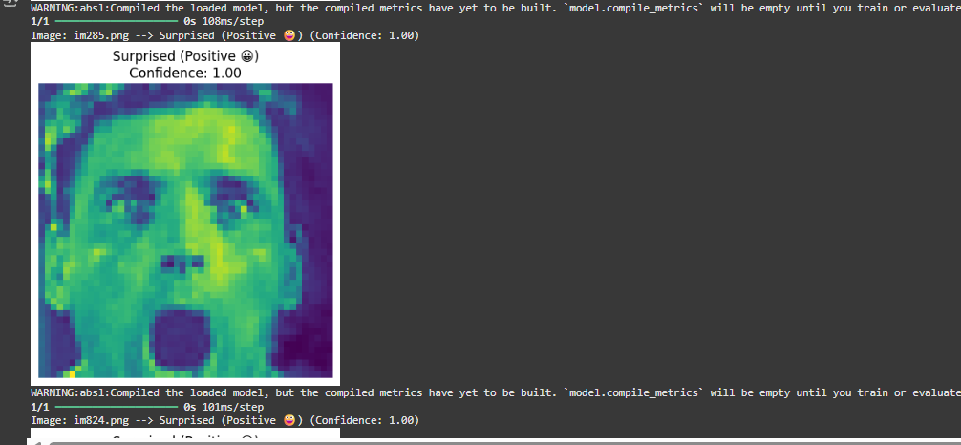

Slide 10
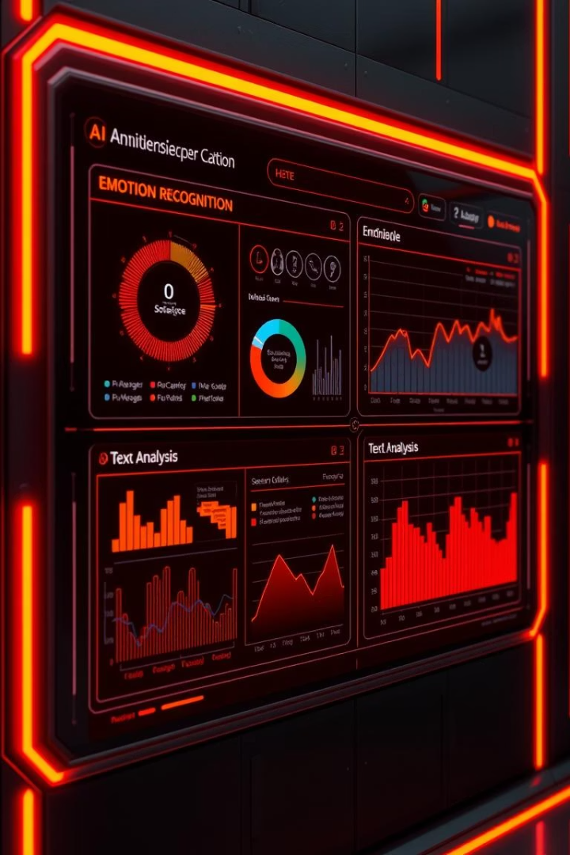
Conclusion and Future Directions
Achievements
Developed a modular multimodal sentiment system with CNN and TextBlob, achieving high accuracy and interpretability.
Limitations
Restricted to four emotions, simplistic text analysis, dataset bias, and offline processing limit real-world applicability.
Future Work
Expand emotion categories, integrate advanced NLP models, use pretrained CNNs, implement attention-based fusion, and develop real-time applications.

